Slide 1
Strategic planning and management

Slide 2
Planning in management
Goals and methods
The essence of planning
Management By Objectives (MBO)
Planning procedure
Types of plans
Barriers to planning

Slide 3

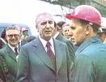
Planning before 1989
Sources: kultowa.korbatz.com, kc-pzpr.webpark.pl,
Notes:
The plan was an obligatory document, usually developed outside the organization. There was a top-down distribution of financial and material resources.

Slide 4

Planning – market economy
Plan – internal organization matter
Mission - a statement of an organization’s fundamental purpose
Source: www.zegarysloneczne.pl

Slide 5
Mission statement
realistic (world number 1? Hmm..)
specific (THE company and no other)
based on distinctive competences
motivating (Yeah! ☺)

Slide 6
Mission statement
„We want to become the leading company in this industry by producing the highest-quality products with the best service at the lowest
prices”

Slide 7
Marketing Plan
Written document
Blueprint/outline of the organization’s marketing activities
Implementation, evaluation and control of marketing activities

Slide 8
Marketing Plan
How the organization will achieve its goals and objectives
Instructs employees about their roles and functions
Allocation of resources
Specifik tasks and responsibilities of individuals
Timing of marketing activities

Slide 9
Orgnizational Mission vs Organizational Vision
Mission statement
What business are we in? (reason for existance)
Vision statement
What do we want to become?

Slide 10
Examples
Google:
Mission:
„To organize the world’s information and make it universally accessible and useful.”
Vision statement:
„Never settle for the best.”

Slide 11
Mission statement
What is your reason for existance?
To make money! (is this a mission statement or just a goal or objective?)
Mission statement identifies what the firm stands for and it’s basic operating philosophy. Profit and other performance outcomes are ends, and thus are out of place and confuse the mission of the firm.

Slide 12
Element of the Mission Statement
Who are we?
Who are our customers?
What is our operating philosophy (basic beliefs, values, ethics, etc)?
What are our core competencies or competitive advantages?
What are our responsibilities with respect to being a good steward of our human, financial, and environmental resources?

Slide 13
How to Write a Mission Statement That Doesn't Suck
https://www.youtube.com/watch?v=LJhG3HZ7b4o

Slide 14
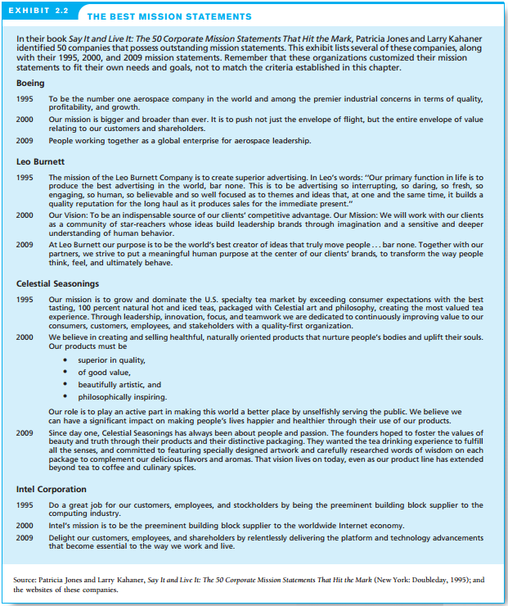

Slide 15
Mission statement
Marketing plan – keep it top secret….
Mission statement – should be told to everyone
Customers
Employees
Investors
Competitors
Regulators
Society in general
WHAT WE STAND FOR. WHY WE EXIST.

Slide 16
Mission statement
Facilitate public relations activities
Communicate to customers and other stakeholders
Information that can be used to build trust and lont-term relationships
Included in annual reports, major press releases
Framed on the wall of every office
Owned by every employee of the organization

Slide 17
Mission statement width
Too broad = meaningless to readers and to build upon
Too narrow = constrain the vision of the organization
„Make all people happy around the world by providing them with entertaining products”
Sounds nice? Too broad? Provides usefull information?
Not too long not too short – not stifle and organization’s creativity, help the firm from not moving too far from its core competencies.

Slide 18
Mission statement
Stable or constantly changing?

Slide 19
Mission statement
Stable or constantly changing?
Goals, objectives, marketing plans -> change over time, annualy, quarterly
Mission changes - > everthing else mus change as well
When to change a mission statement?
No longer in sync with the firm’s capabilities
Competitiors push the firm from a market
New technology changes customer needs
New opportunity matching the strengths and expertise.

Slide 20
Customer-Focused Mission Statements
Southwest Airlines (hasn’t changed mission statement since 1988)

Slide 21
Mission statement of Southwest
https://www.youtube.com/watch?v=eGxMf88I5g4
https://www.youtube.com/watch?v=8_CeFiUkV7s
https://www.youtube.com/watch?v=JLkBu0xcXLY
https://www.youtube.com/watch?v=8_CeFiUkV7s&t=80s
https://www.youtube.com/watch?v=HLVlZwkZGt4&list=PLVvOfNI1879HJfzuQDt08UuOzolCtzazd&index=7

Slide 22
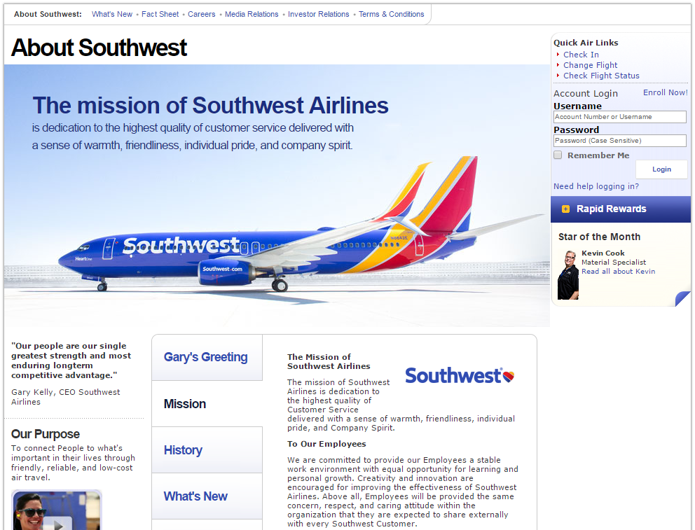

Slide 23

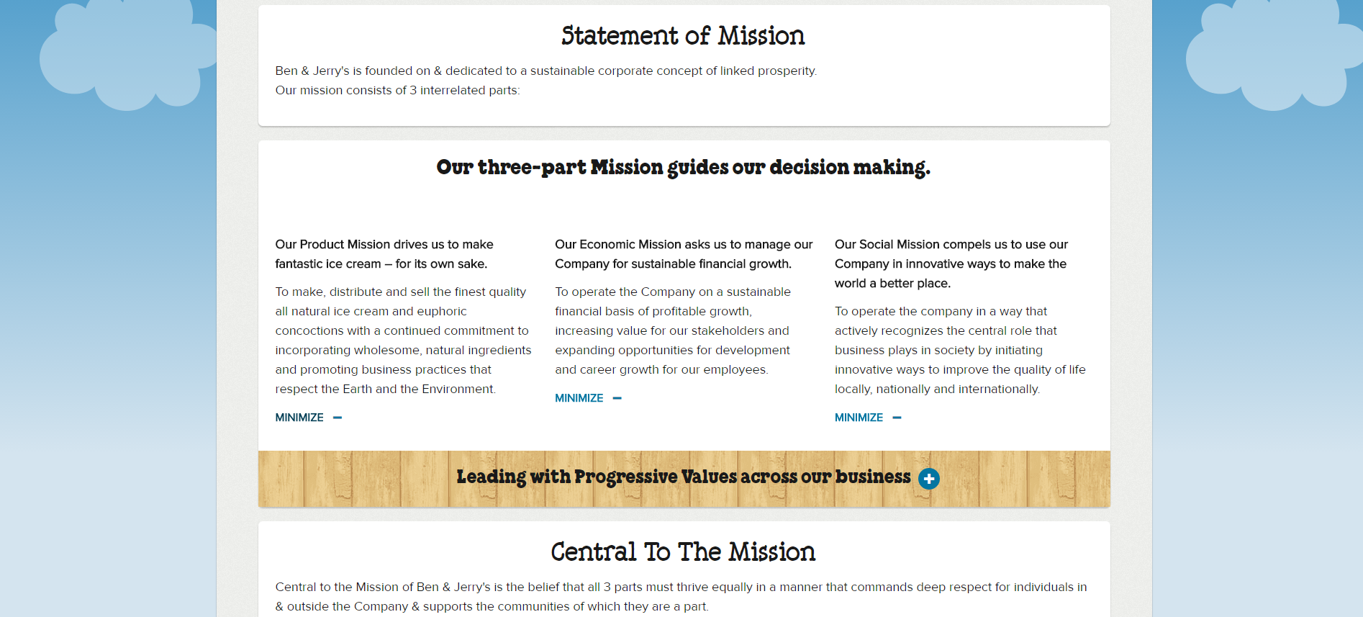

Slide 24
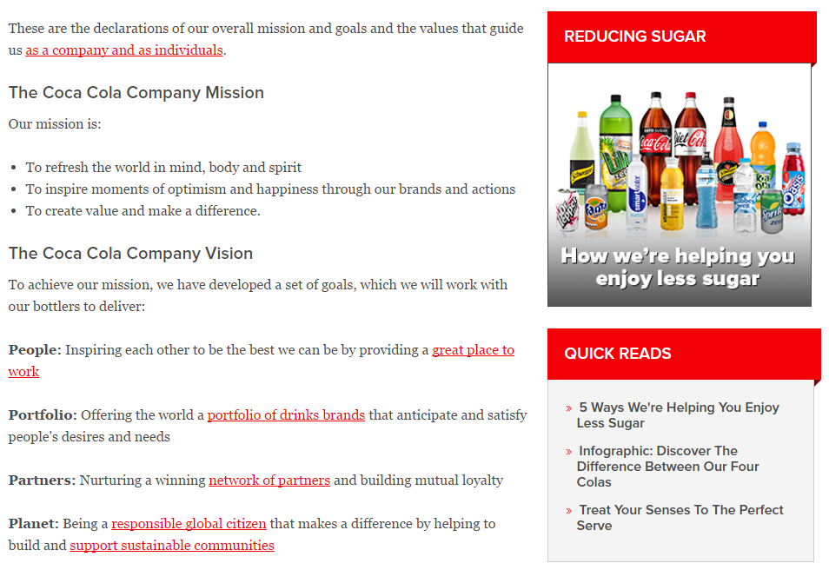

Slide 25
https://www.youtube.com/watch?v=Me3ysnLmNmE
https://www.youtube.com/watch?v=059H62fBWmg
https://www.youtube.com/watch?v=LJhG3HZ7b4o
https://www.youtube.com/watch?v=DJ5ICrjhzC4
https://www.youtube.com/watch?v=b2MyaR0gMo0&t=9s
https://www.youtube.com/watch?v=HGNPWDdKiws

Slide 26
Goal
0-1 ☺
What should be achieved?
Where should this be done?
What is the deadline?
+
What measures will be needed to achieve the goal?
Notes:
A well-formulated goal should help answer the question: has the goal been achieved? Yes/No/. The goal should be set using the following set of questions.

Slide 27
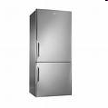
Strategic goals
1. Strategic goal - a goal set by and for
an organization’s top management
Strategic goal: achieving a 6% share in the domestic fridge production industry over a 5-year time horizon
Source: freshlaundry.wordpress.com

Slide 28

Tactical goals
2. Tactical goal - a goal set by and for
an organization’s middle managers
Construction of a new fridge factory/
Modernization and extension of the existing refrigerator factory
Source: www.rynek-lodzki.pl
Notes:
Tactical goals are linked to strategic goals and reflect ways of achieving them.

Slide 29
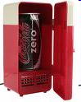
Operational goals
3. Operational goal - a goal set by and for
an organization’s lower-level managers
Ordering materials for the production of refrigerators
Graphic design of a fridge
Source: tech.oldcoconut.com
Notes:
They concern short-term problems related to achieving tactical goals.

Slide 30
Setting goals - problems
Who should set individual goals?
Lack of consistency of goals
Competitiveness of goals optimization
Autonomization of goals
Existing restrictions
Notes:
Who should set individual goals? - it is theoretically known that strategic goals are set by the highest levels, etc., but sometimes, depending on the company's culture, the level of independence of the lower level managers is adopted, they know the lower goals themselves (and sometimes they have data in advance) Lack of consistency - Nike, for example, produced high-quality footwear (production target) that was out of fashion (marketing target). They lost market share to Reebok. They regained position after recognizing and correcting goals. Competitiveness of goals - no company has unlimited resources, and there are usually many goals. The most important goals for the functioning of the organization must be selected, taking into account various distortions, e.g. the unreliability of the cooperating party. Optimization = the process of choosing the goals that best meet the criteria. Autonomization of goals - organization's goals are mostly focused on survival and development. That is why we sometimes deal with a situation when an organization "breaks away" from its original function. This is a pathological phenomenon, but understandable from the point of view of the organization. Example: selling „bricks” by hospitals (detachment from the original goal of free treatment, organization; but without „bricks” there would be no medicine). Existing restrictions - they must be taken into account, otherwise the goals will be ambitious and unrealistic. And you have to remember that one should try to involve all employees of the organization in the process of setting goals. But - it depends on the culture and atmosphere in the organization. Plus in each organization there are different interests of different groups.

Slide 31
Management by Objectives (MBO)
A strategic management model that aims to improve the performance of an organization by clearly defining objectives that are agreed on by both management and employees.
The degree of achievement of goals should be a key factor in employee evaluation and rewarding

Slide 32
Management by Objectives (MBO)
Comprehensive ☺
Planning - by setting goals
Organizing - by delegating authority to decide and take responsibility, and by providing means to achieve goals
Motivating - by conducting conversations with colleagues, objective evaluation and remuneration
Control - by evaluating the results against the goals
Notes:
Includes all basic management functions. The main benefit - better employee motivation, clear definition of tasks + improved communication. Focusing on the right goals, one can select the most useful employees for promotion. Disadvantages - the system is doomed to failure if it is not supported by top management, managers must willingly support the proposed changes and not be assigned to the program by force. Plus, developing a specific list of individual goals can be costly and difficult. The main thing - a clear wording of the goal.

Slide 33

Planning procedure
Criteria for categorizing plans:
Management level (strategic, tactical, operational)
Time horizon (long-term, medium-term, short-term)
Problem (production, marketing, logistics etc.)
Intended use (e.g. construction of a supermarket, trip to Mount Everest)
Source: www.letsgodigital.org
Notes:
Plans - related to the organization’s goals.

Slide 34
Planning procedure
The Organization’s Mission
Strategic goals
Strategic plans
(over 5 years)
Tactical goals
Tactical plans
(1 – 5 years)
Operational goals
Operational plans
(1 month – 1 year)
Notes:
Strategic plan - a general plan outlining decisions about the resource allocation, priorities, and action steps necessary to reach strategic goals.
Operational plan - a plan that focuses on carrying out tactical plans to achieve operational goals.

Slide 35
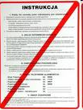
Planning procedure
Operational plan - implementation of specific standard tasks.
Sometimes: operational plan = contingency plan
Source: www.lulex.com.pl
Notes:
Contingency plan - actions in case of threat to the organization, e.g. in the event of fire, natural disasters, etc. It is placed in a visible place in every organization, and in hotels in every room. But usually the operational plan concerns standard marketing, production and finance activities.

Slide 36

Business plan ☺
„The organization's action plan”
„Business plan”
Source: www.restaurantcoachingsolutions.com Business Plan Market Segmentation

Slide 37
Planning process
General plan construction procedure:
1. Problem formulation
2. Problem situation analysis
3. Proposed plan of the optimal strategy to achieve the assumed goals
4. Verification of the submitted proposal
5. Implementation of the plan

Slide 38
Barriers to planning
BARRIERS:
Wrong goals
Poorly-designed reward system
Dynamic and complex environment
Reluctance to set goals
Resistance to change
Limitations

Slide 39
Barriers to planning
Contradictions between plans (strategic and lower levels)
Not involving managers of important departments in the work on the strategic plan
Treating strategic plans as unchangeable
Not distinguishing the strategic plan from forecasting
Inserting too many details in the plan

Slide 40
Strategic planning and management
Strategy = a plan of action designed to achieve a long-term or overall aim
Strategy = the art of planning and directing overall military operations and movements in a war or battle ☺
Strategy = a comprehensive plan for accomplishing an organization’s goals (Griffin)

Slide 41
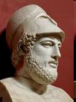
Strategy
Strategy (gr) – art of the conduct of war
Planning (when to fight, provide supply lines, manage relations between the army, citizens, politicians, etc.) + acting
Sources: www.blogi.szkolazklasa.pl
Notes:
Pericles

Slide 42



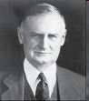

Strategy
Sears, Roebuck & Co.
general Robert E. Wood
Sources: www.academyofachievement.org, antiquebooks.typepad.com, epguides.com, www.sirloz.blogspot.com
Notes:
In the 20s, Sears, Roebuck & Co was a huge mail ordering catalog company whose president, General Robert E. Wood, understood the importance of strategy. Wood noticed that the growing popularity of cars will allow more and more of their owners to commute to cities. Therefore, a long-term strategy to transform the company from a mail order house into a retail chain was implemented. It brought huge success.

Slide 43

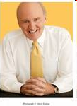
Strategic plan?
The 1970s - "enterprises should carefully and deliberately analyze what they want to do and how they want to do it"
The 1980s - quality improvement, restructuring,
staff reduction, improvement of efficiency
Today ☺
- engaging the company’s own managers in the planning process (instead of building numerous planning teams)
- caution, logic and rationality instead of chasing growth and expansion
Sources: entrepreneursofktown.ning.com, www.bumbasymposium.com
Notes:
In the 1970s, the development of the company's strategy was considered to be a key activity. The corridors of the companies were traversed by well-paid graduates of management studies, preaching various wisdoms. In the 1980s, global competition forced many large companies to retreat from such thought-out strategies. The focus was on tactical problems. Jack Welch dissolved the famous GE 200 planning team in 1983. Then the strategy = using such business opportunities that were revealed during the normal course of events. Today: a return to a well-thought-out strategy, but unlike in the 1970s - instead of numerous staffs, the company’s own managers are involved.
„Neutron Jack”
To attract the right personnel, Welch instituted a strategy that earned him the moniker "Neutron Jack." He had GE cut all businesses in which the company could not dominate the market in first or second positions. Next, he had managers fire the bottom 10% of GE employees, and he fired the bottom 10% of management. Welch's housecleaning cleared away layers of bureaucracy and made way for a quicker flow of ideas.

Slide 44
Strategic plan
Contemporary strategic planning:
1. High flexibility of the strategic management process:
promoting critical self-evaluation
change is a normal condition, not a pathology
2. Meeting the challenges facing modern organizations:
exploring the organization's strengths and weaknesses
taking into consideration the organization's environment

Slide 45
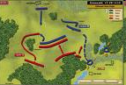
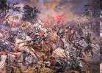
Strategic management
Strategic management – a process involving the development of strategic plans and then acting on the basis of these plans
Sources: www.taktykaistrategia.pl, www.sp236gim61.neostrada.pl

Slide 46
Strategic management
Setting goals
Strategic planning
Formulating strategy
Administration
Strategy implementation
Strategic control

Slide 47

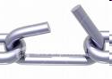

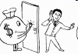
SWOT
Strenghts | Weaknesses
Opportunities | Threats
Sources: www.blog-o-h2o-3-syrenkach.bloog.pl, www.aperfectworld.org, professionalbankingjobinterviews.com, www-users.mat.uni.torun.p

Slide 48
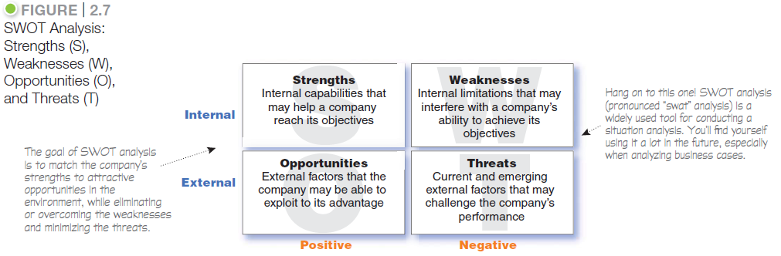
SWOT Analysis

Slide 49
Management - SWOT Analysis
Strengths (internal)
Weaknesses (internal)
Opportunities (external)
Threats (external)

Slide 50
Porter’s 5 Forces Analysis
Threat of new entrants
Bargaining power of suppliers
Bargaining power of buyers
Rivalry among existing competitors
Threat of substitute products

Slide 71
Portfolio analysis
1. to identity the key businesses making up the company = strategic business units.
An SBU: a company division, a product line within a division, a single product or a brand.
2. to assess the attractiveness of its various SBUs

Slide 72

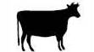

BCG growth share matrix
 | HIGH Relative market share | LOW Relative market share
HIGH Market growth rate
LOW Market growth rate
Notes:
72

Slide 73
BCG growth share matrix
1. Stars
High-growth, high-share businesses or products. They often need heavy investment to finance their rapid growth. Eventually their growth will slow down, and they will turn into cash cows.
2. Cash cows
Low-growth, high-share businesses or products.
Established and successful SBUs that need less investment to hold their market share. Thus they produce cash that the company uses to pay its bills
and to support other SBUs that need investment.

Slide 74
BCG growth share matrix
3. Question marks
Low-share business units in high-growth markets. They require cash to hold their share, let alone increase it.
4. Dogs
Low-growth, low-share businesses and products. They may generate enough cash to maintain themselves, but do not promise to be large sources of cash.

Slide 75


BCG growth share matrix
Each SBU has a life cycle
An example: A new product…
The beginning
The success ☺
Market growth falls:
The end ☹
And…. A new product….

Slide 76
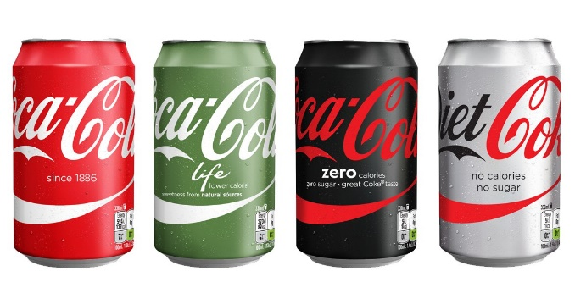
Where would you put the following products in the BCG matrix?
Draw a BCG matrix and place the products from the coca-cola company in this matrix.
Justify your answer! Rember it is important to specify which market we’re talking about.
CocaCola Classic
Coca Cola Light (Diet Coke)
CocaCola Zero
Coca Cola life

Slide 77
Marketing mix
The MARKETING MIX – 4 Ps
Product
Price
Place
Promotion

Slide 78
4Ps vs 4Cs
4 Ps | 4 Cs
Product | Customer solution
Price | Customer cost
Place | Convenience
Promotion | Communication

Slide 79
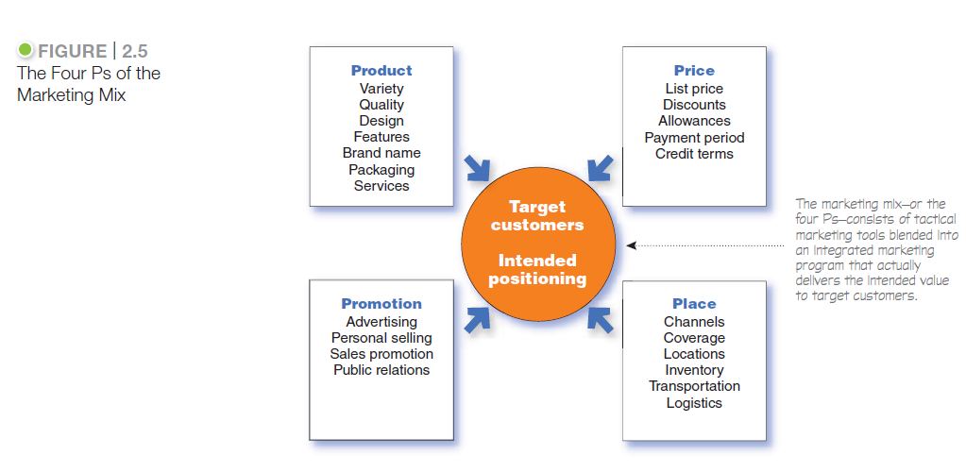

Slide 80
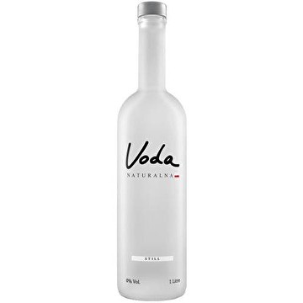
Woda Voda Naturalna
Product: (what need does it satisfy?)
Price: 12pln / liter
Place: sold only in upperscale grocery stores or
durring fashion shows, premiers etc
Promotion: word of mouth, celebrities
https://www.youtube.com/watch?v=7ZvDEHvAPRY

Slide 81


Slide 82
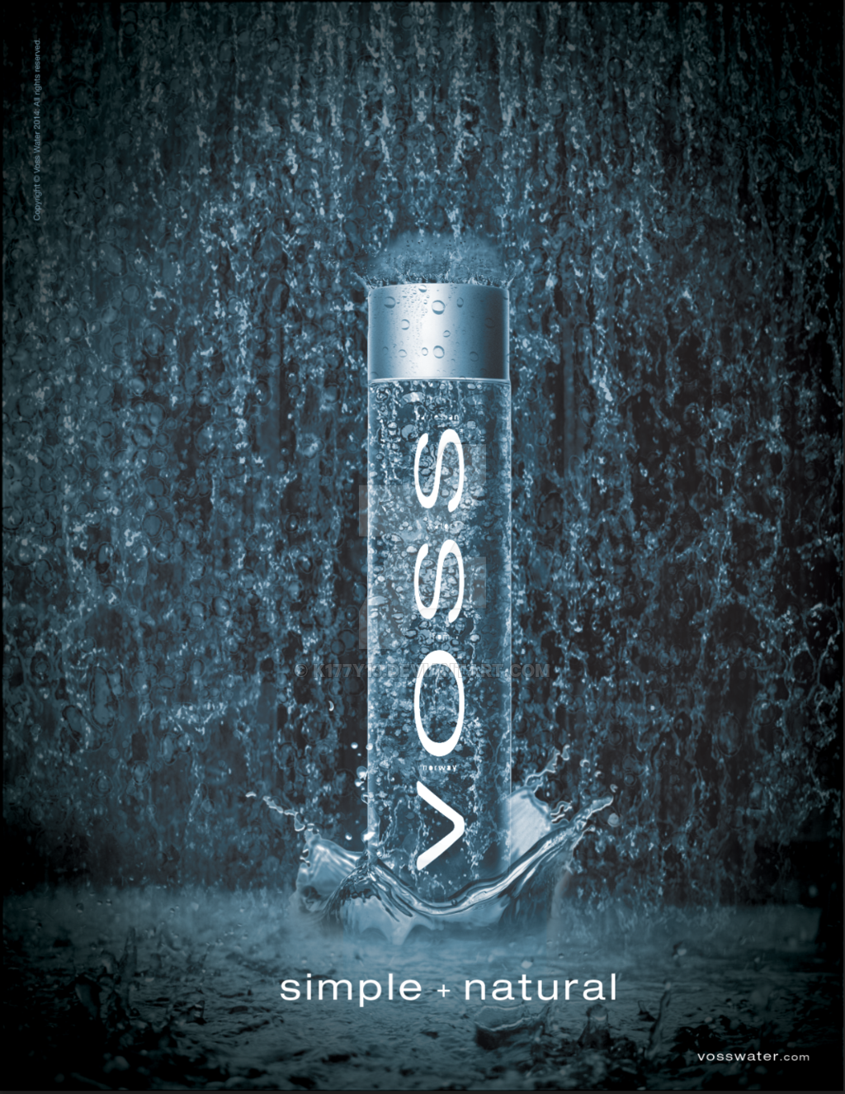

Slide 83
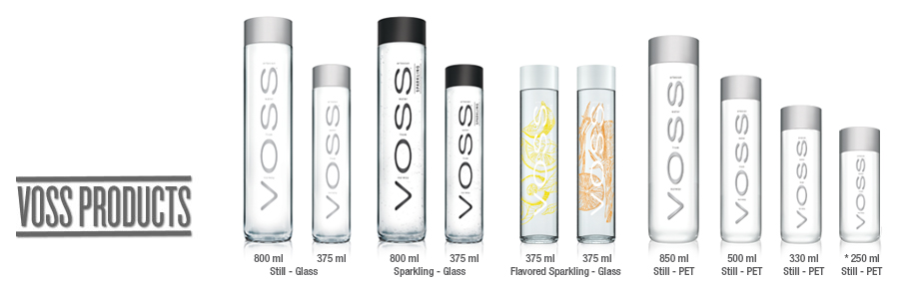

Slide 84


Slide 85
Market Segmentation
Market Segmentation
Dividing a market – buyers who have different:
needs
Characteristics
Behaviors
……and require seperate products or marketing programs
Market segment
A group of consumers who respond in a similar way to a given set of marketing efforts

Slide 86
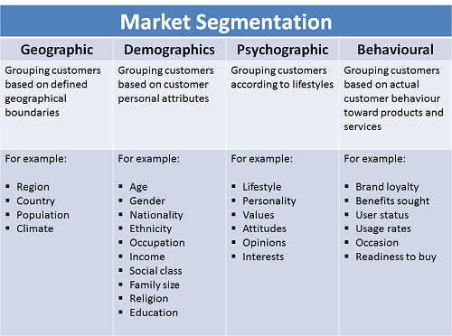

Slide 87
The GE McKinsey Matrix
Attractiveness of the market | Competitiveness and competence of the SBU
 | High | Medium | Low
High | Invest/grow ☺ | Invest/grow ☺ | Hold/selective
Medium | Invest/grow ☺ | Hold/selective | Divest/harvest
Low | Hold/selective | Divest/harvest | Divest/harvest
Notes:
In the 1970s, General Electric (GE) commissioned McKinsey & Company to develop a portfolio analysis matrix for screening its business units. The GE McKinsey Matrix or GE Matrix is a variant of the Boston Consulting Group (BCG) portfolio analysis.
GE McKinsey Matrix vs BCG Matrix
The GE McKinsey Matrix bears a strong resemblance to the BCG Matrix. However, there are some differences:
The GE McKinsey Matrix does not only consider growth, it mainly considers market attractiveness.
In addition to market share the GE McKinsey Matrix also considers the strength of a business unit.
Instead of the four cells that are created in the BCG Matrix, the GE McKinsey Matrix creates nine cells.
87

Slide 88


Blue Ocean Strategy
Blue ocean strategy
How to create a free market space and make competition irrelevant?
„The market universe” – 2 oceans:
Sources: www.ekonomicznie.pl, www.wywrota.pl
Notes:
Red oceans are all the industries in existence today – the known market space. In red oceans, industry boundaries are defined and accepted, and the competitive rules of the game are known.
Here, companies try to outperform their rivals to grab a greater share of existing demand. As the market space gets crowded, profits and growth are reduced. Products become commodities, leading to cutthroat or ‘bloody’ competition. Hence the term red oceans.
Blue oceans, in contrast, denote all the industries not in existence today – the unknown market space, untainted by competition. In blue oceans, demand is created rather than fought over. There is ample opportunity for growth that is both profitable and rapid.
In blue oceans, competition is irrelevant because the rules of the game are waiting to be set. A blue ocean is an analogy to describe the wider, deeper potential to be found in unexplored market space. A blue ocean is vast, deep, and powerful in terms of profitable growth.
Blue Ocean Strategy – examples:
Ford Model T
Viagra

Slide 89

The components of a strategy
Competitive advantage/distinctive competence: an organizational strength possessed by only a small number of competing firms
Scope: the range of markets in
which an organization will compete
Resource deployment: how an organization
distributes its resources across the areas in which it competes
Source: www.poppendieck.com/ graphics/j0078772.gif
Notes:
Scope: Hershey Foods has essentially restricted its scope to the confectionery business. In contrast, its biggest competitor, Mars, has adopted a broader scope by competing in the pet food business and the electronics industry, among others. Some organizations, called conglomerates, compete in dozens or even hundreds of markets.
Resource deployment: General Electric, for example, has been using profits from its highly successful U.S. operations to invest heavily in new businesses in Europe and Asia. Alternatively, the firm might have chosen to invest in different industries in its domestic market or to invest more heavily in Latin America.

Slide 90

Competitive advantage
Competitive advantage/distinctive competence
Strategic imitation ☺
Lasting/sustainable/durable competitive advantage ☺ ☺:
the competitive advantage that persists when all attempts at strategic imitation have been discontinued.
Source: www.britfilms.tv
Notes:
A distinctive competence is a strength possessed by only a small number of competing firms. Distinctive competencies are rare among a set of competitors. When George Lucas founded Industrial Light & Magic (ILM), for example, the new venture brought the cinematic art of special effects to new heights. Organizations that exploit their distinctive competencies often obtain a competitive advantage and attain above-normal economic performance.

Slide 91

Competitive advantage
Lasting competitive advantage – sources:
Unique historical circumstances
Effective secret-keeping
Teamwork or organizational culture
Source: bizzcrunch.blogspot.com
Notes:
Unique historical circumstances - e.g. Caterpillar was the only company that met the army's technical requirements during the war and was then awarded a long-term contract.
Effective secret-keeping
Teamwork or organizational culture - difficult to follow/copy

Slide 92
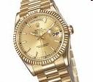
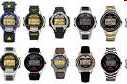

Porter’s generic strategies
Differentiation strategy
Overall cost leadership strategy
Focus strategy
+ Middle-of-the road
Sources: images.businessweek.com, www.encodeteam.com, www.globalgiants.com
Notes:
Differentiation strategy - strategy in which an organization seeks to distinguish itself from competitors through the quality of its products or services. cost leadership, or focus strategy at the business level. Firms that successfully implement a differentiation strategy are able to charge more than competitors because customers are willing to pay more to obtain the extra value they perceive. Rolex pursues a differentiation strategy.
Overall cost leadership strategy - a strategy in which an organization
attempts to gain a competitive advantage by reducing its costs below the costs of competing firms. By keeping costs low, the organization is able to sell its products at low prices and still make a profit. Timex uses an overall cost leadership strategy. For decades, this firm has specialized in manufacturing relatively simple, low-cost watches for the mass market.
Focus strategy - a strategy in which an organization concentrates on a
specific regional market, product line, or group of buyers.

Slide 93

Porter’s generic strategies
Differentiation strategy:
emphasis on quality (cost control less important)
satisfaction of a demanding customer (accepting returns, costly maintaining a stock of finished products, tailoring products to individual needs)
creativity, innovation
Overall cost leadership strategy:
broad advertising campaign (emphasis on reliability values, not distinctive features)
strict accounting and financial control
long series of standardized products
increasing production scale
priority: cost reduction
Source: images.businessweek.com
Notes:
Cost reduction: ordinary, unpainted buildings; Wal-Mart has the words "Please, help us keep your costs low" - thus asking customers to return their carts to the parking lot.

Slide 94


Diversification?
Single-product strategy
Related diversification
Unrelated diversification
Mergers, purchases and acquisitions
Sources: kener.elektr.polsl.pl, fdb.pl
Notes:
Diversification
The number of different businesses that an organization is engaged in and the extent to which these businesses are related to one another.
Single-product strategy
A strategy in which an organization manufactures just one product or service and sells it in a single geographic market. The single-product strategy has one major strength and one major weakness. By concentrating its efforts so completely on one product and market, a firm is likely to be very
successful in manufacturing and marketing the product. Because it has staked its survival on a single product, the organization works very hard to make sure that the product is a success. Of course, if the product is not accepted by the market or is replaced by a new one, the firm will suffer. This happened to companies that manufactured only black-and-white televisions when low-priced color televisions were first mass-marketed.
Related diversification - a strategy in which an organization operates in several businesses that are somehow linked with one another.
Unrelated diversification - strategy in which an organization operates multiple businesses that are not logically associated with one another.

Slide 95
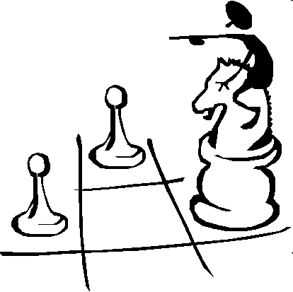
The choice of the strategy?
A lot of factors ...
Source: www.poppendieck.com/ graphics/j0078772.gif

Slide 96

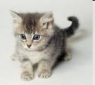
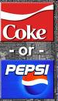
The choice of the strategy?
Sources: www.koty.wb.pl, www-users.mat.uni.torun.pl, www.lasvegasvegas.com
Notes:
How big are we and our rivals?
Are we operating in a very competitive industry where the fight for life and death is ongoing?

Slide 97
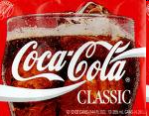
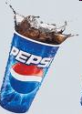


The choice of the strategy?
Sources: allegro.pl
www.stolarka.kielce.com
Notes:
The choice of strategy depends on many factors already mentioned - how big are we, what is our competitive position (leader, challenger, follower, nicher), whether the environment is very competitive or not.

Slide 98
Postioning – Lucky Stike – It’s Toasted
Mad Men – https://www.youtube.com/watch?v=X4p_oCFLdJE

Slide 99
Market position
Competitive Positioning:
Market leader
Market challenger
Marker follower
Market nicher

Slide 100
Competitive Positioning
Market leader
The firm in an industry with the largest marker
share; it usually leads other firms in price
changes, new product introductions, distribution coverage and promotion spending.

Slide 101
Competitive Positioning
Market follower:
chooses to follow rather than challenge the market leader. Firms using market follower
strategies seek stable market shares and profit by following competitors' product offers, prices and marketing programs.
Source: allegro.pl

Slide 102
Competitive Positioning
Market nicher:
specializes in serving market niches that large competitors overlook or ignore.
„New doors, old frames”
Source: www.stolarka.kielce.com

